Slide 1
Interfacing of Bulb and Buzzer with Beaglebone Black Project : Car Over-speed detection system
SUBMITTED BY:
Sunny Devgan (C0752045)
Group #4

Slide 2
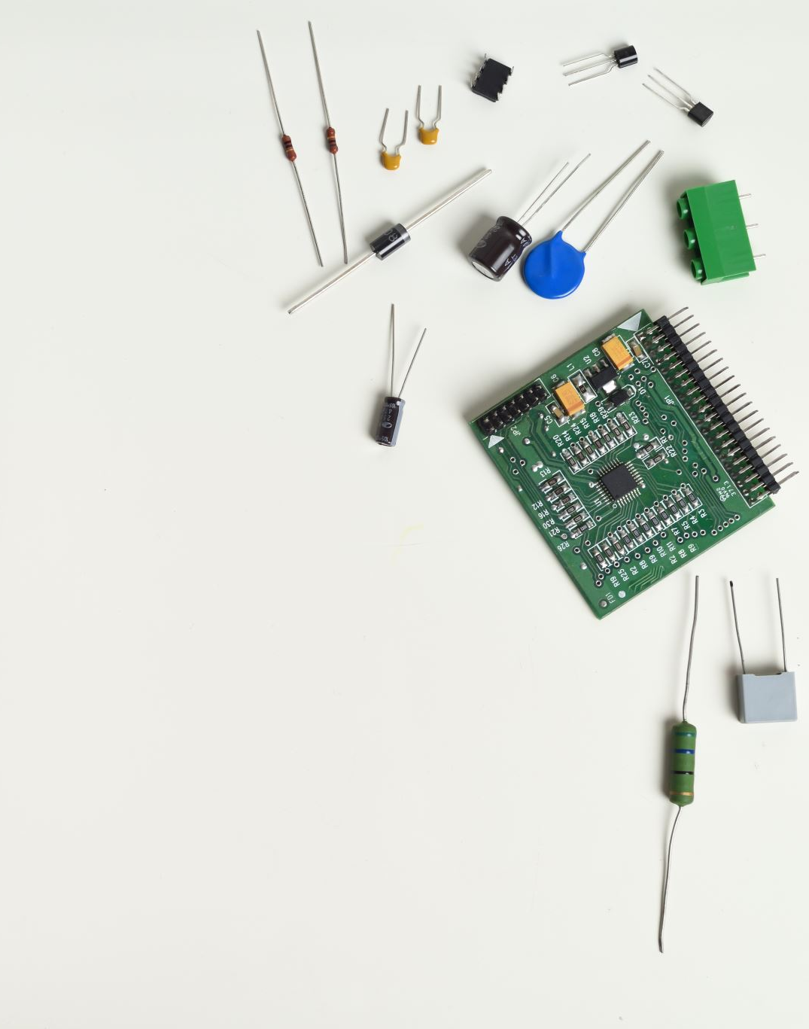
Contents
Block Diagram of project
Software and hardware used in interfacing
Introduction of Piezo Buzzer
Introduction of Bulb and Bulb holder
Introduction of Relay
Connection of bulb with relay
Connection of bulb and buzzer with Beaglebone black
Coding of bulb and buzzer with Beaglebone black
Terminal command used in installation of library in Beaglebone
Terminal final output
References.

Slide 3
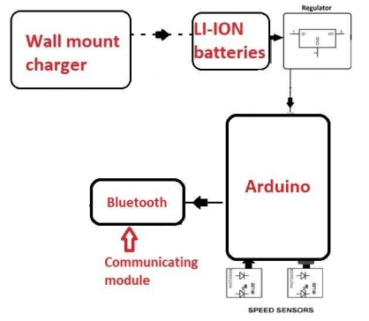
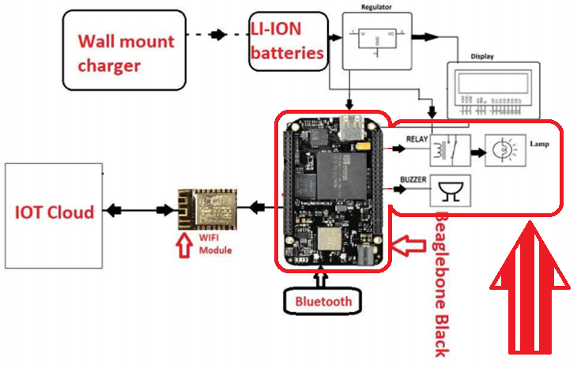
Introduction of Arduino
Block Diagram of project

Slide 4
Software and hardware used in interfacing
Hardware used
Bulb, buzzer ad relay module
Beaglebone Black
Jumper cables
USB cables
Software Used
Eclipse IDE
Putty
Nano Editor
GCC compiler
Terminal

Slide 5
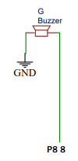
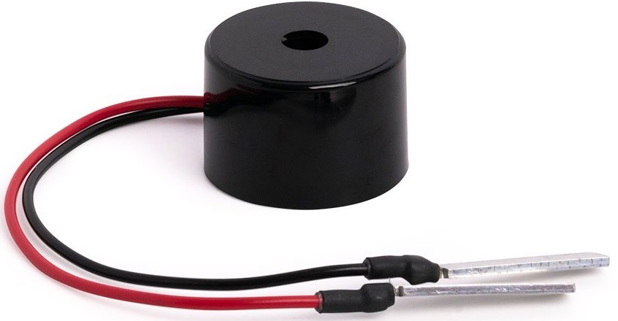
Introduction of Piezo Buzzer
The Piezo Buzzer emits a high-pitch beep to get the attention of the user.
It requires 3V power supply to work properly.
There are two wires for connections.
One wire of the Piezo buzzer is connected to the port 8 pin 8 of Beaglebone Black and second wire is connected to the GND.

Slide 6

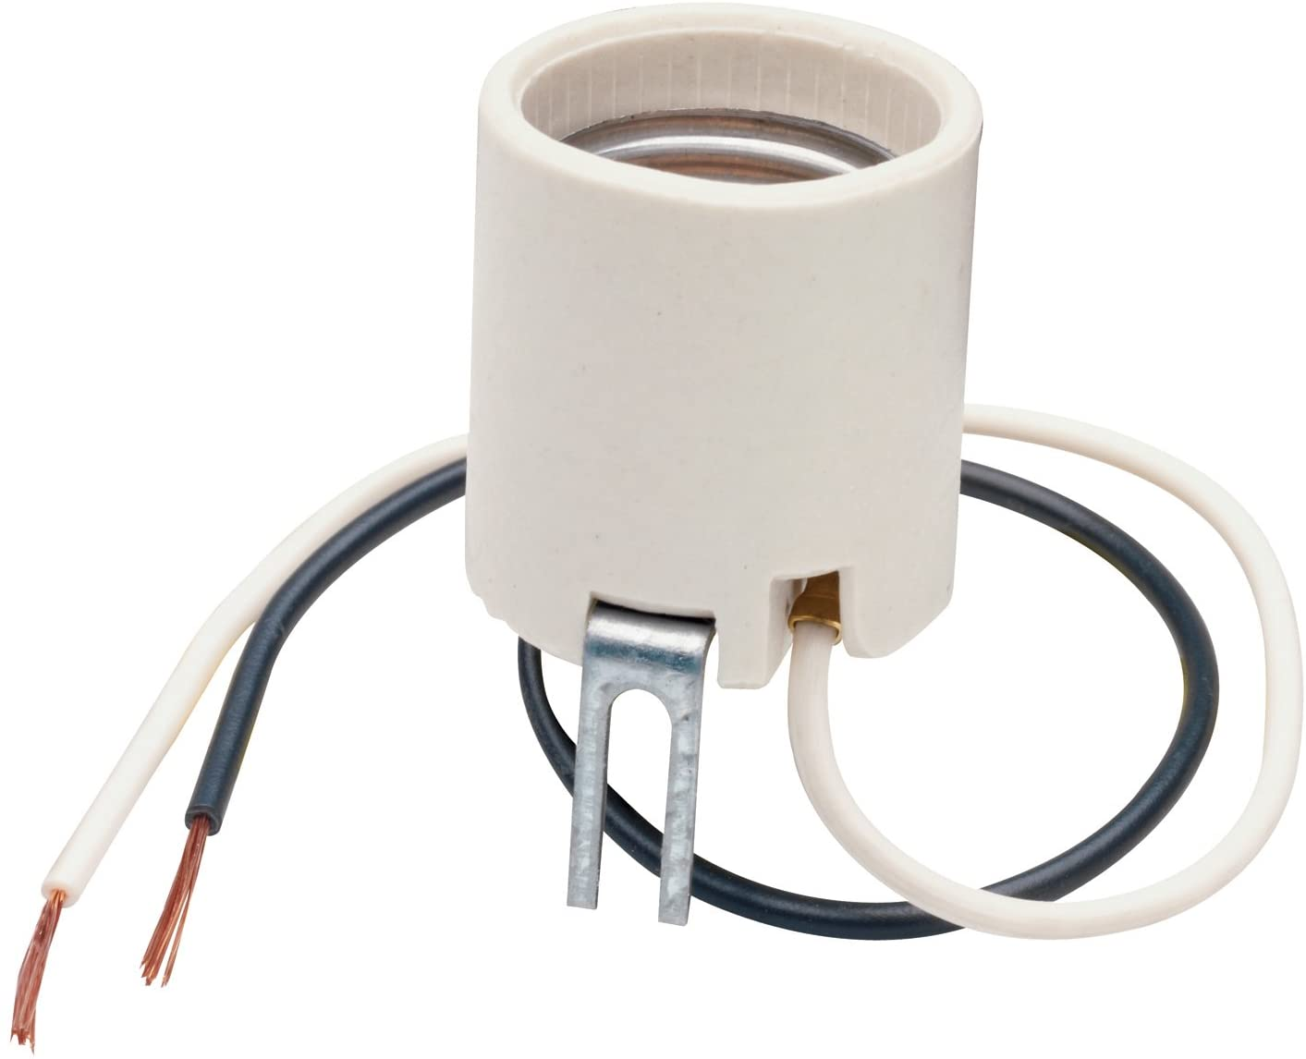
Introduction of Bulb and Holder
Power requirement of the bulb is 12V.
We plug the bulb into the bulb holder which have two output wires (positive and negative).
These two wires are connected to the Relay module.
The requirement of the relay is because the Beaglebone can only 5V out.

Slide 7
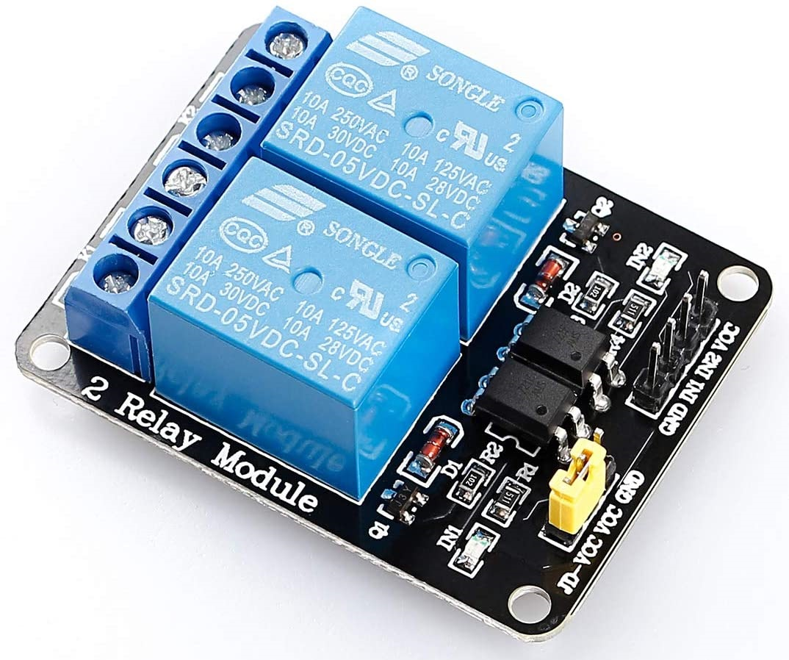
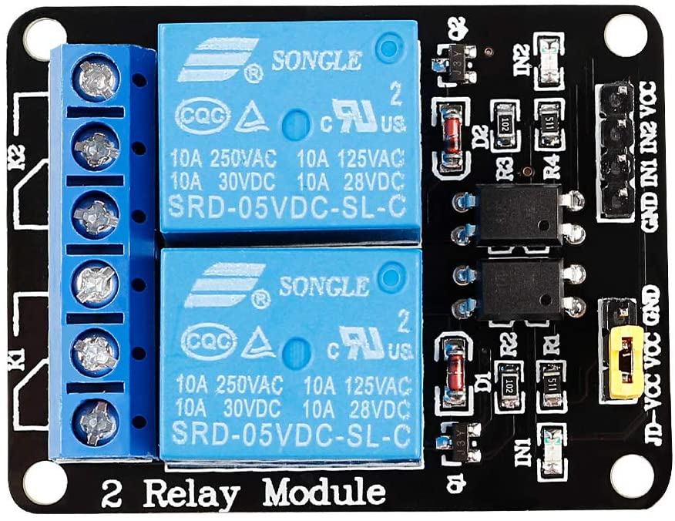
Introduction of Relay Module
This is a dual channel interface module.
One channel is used in our project
The reason behind using the relay is Beaglebone Black can give 5V max output but, bulb needs minimum 12V to turn ON.
Beaglebone gives the signal to the relay module and it turns ON the bulb with the help of extra battery attached with that.

Slide 8
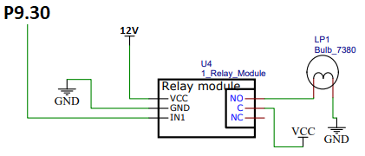
Connections of Bulb with Relay module
Port 9 pin 30 is connected to the relay module pin IN1
GND is connected to GND
VCC of relay module is connected to 12V
NO (normally open) pin is connected to one wire of the bulb and other wire GND
C (common) is connected to VCC

Slide 9
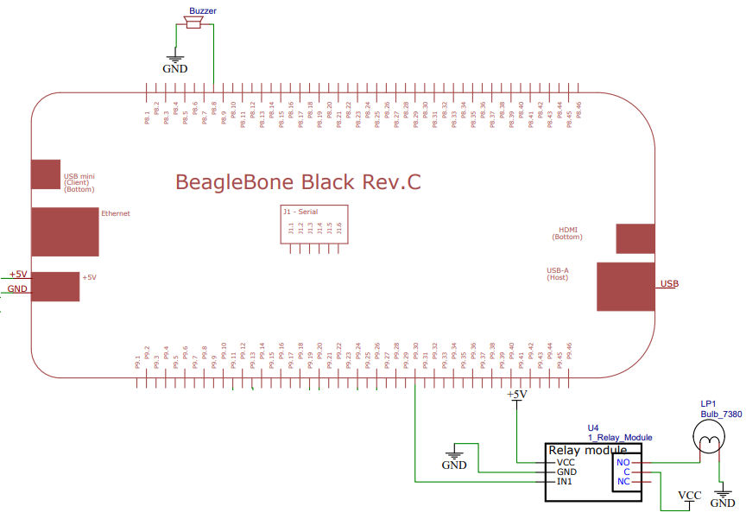
Connections of Bulb and Buzzer with Beaglebone Black
Buzzer is directly connected to the Beaglebone black on the port 8 pin 8
Second wire of the buzzer is grounded
Bulb is connected through the relay module on the Beaglebone black port 9 pin 30.
Both the pins are GPIO pins

Slide 10
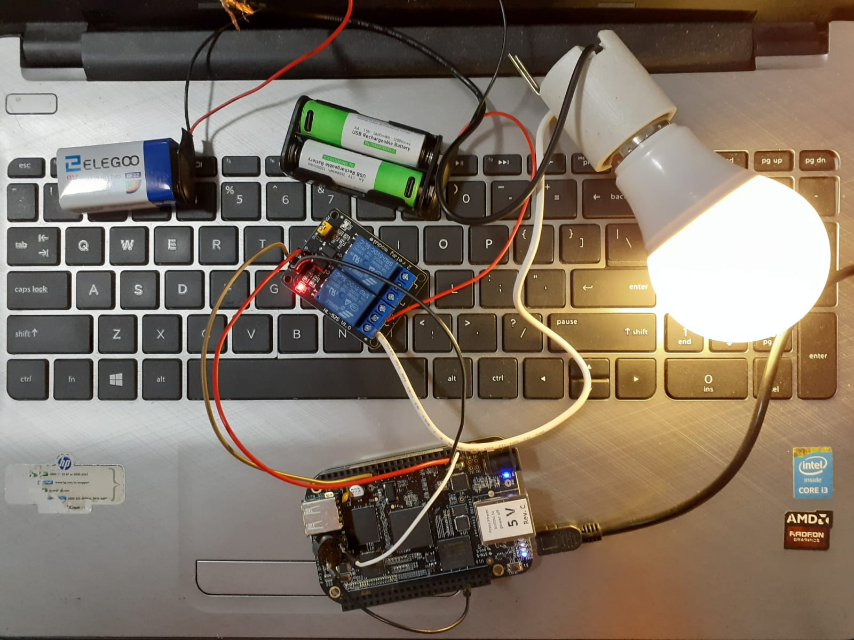
Connections of Bulb, Buzzer and relay
Video of working circuit : https://www.youtube.com/watch?v=O1TqyoDxItE

Slide 11
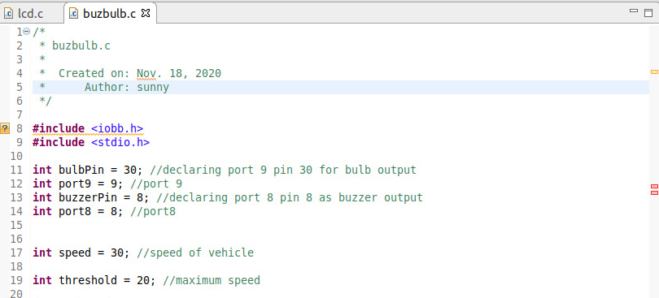
Coding of Bulb and Buzzer with Beaglebone Black
Included input output Beaglebone black library and standard input output library.
Then connected the bulb via relay module to p9 30 and Buzzer to P8 8.
The speed is set to 30 as the speed of vehicle for test.
The threshold speed is set to 20.

Slide 12
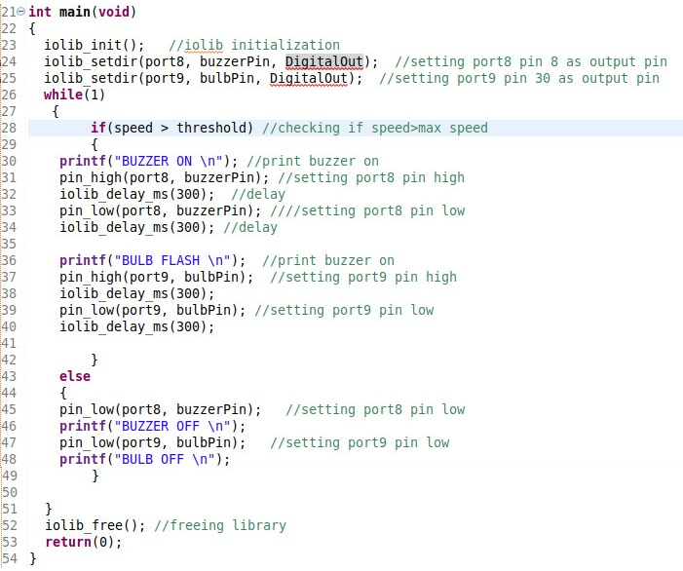
Coding of Bulb and Buzzer with Beaglebone Black (cont.d)
Setting port 8 pin 8 as output for buzzer and port9 pin30 output for bulb.
Delays of 300 milli-seconds are used in between every statement to give some time for checking.
Inside the while loop we are checking the condition is the speed of higher than threshold speed or not.
If the speed is less than threshold bulb stays off and buzzer will not make any noise.
Else condition says there is a car over-speeding and bulb lights up and buzzer rings.

Slide 13
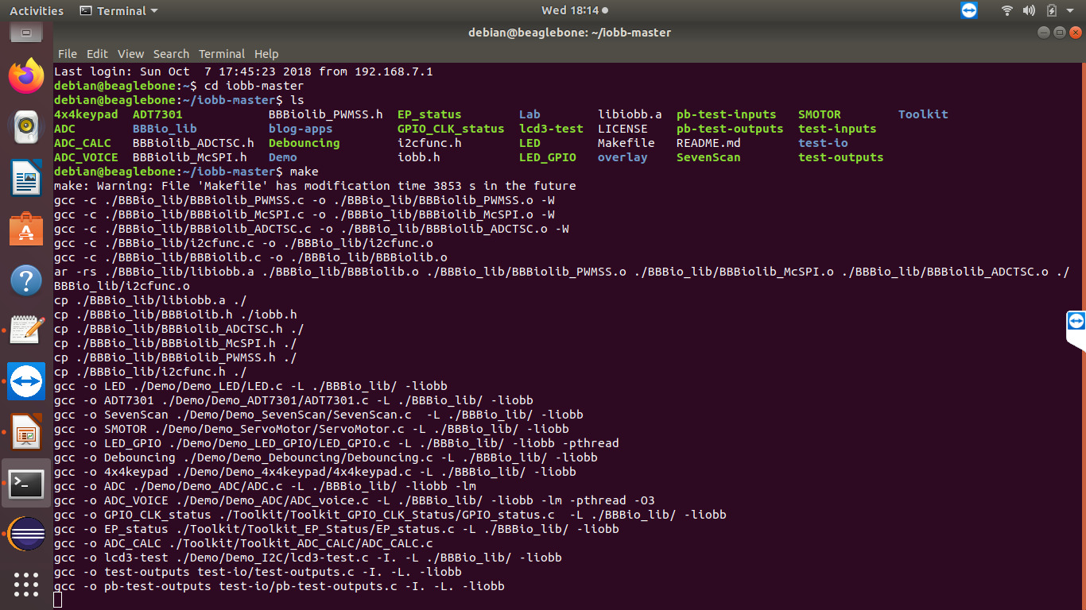
Terminal commands used to install library
To install the library open the directory “cd” then library folder “iobb-master$ ls”
“Make” command is required next make executable file. Then system will take some time to execute the command and open the file

Slide 14
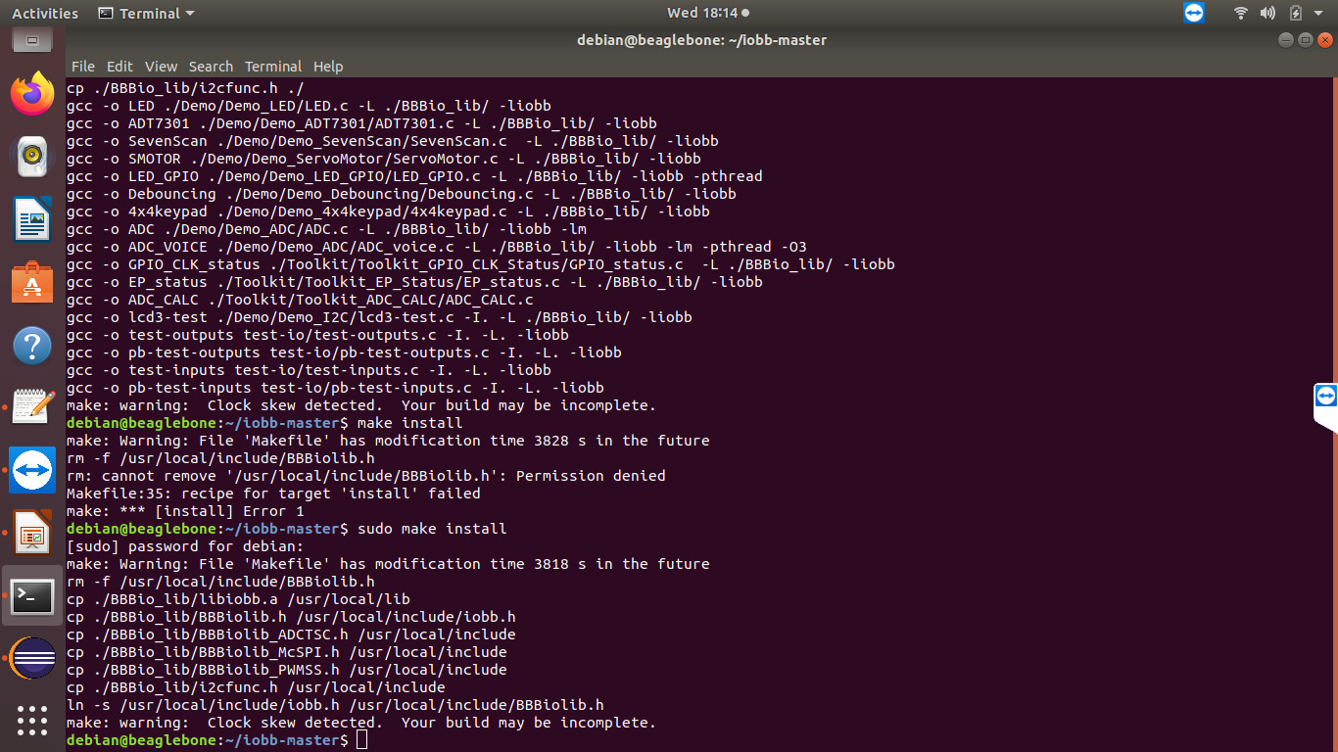
Terminal commands used to install library
Next command is to install the make file command is “sudo make install”
The library is installed in the Beaglebone Black and ready to use.

Slide 15
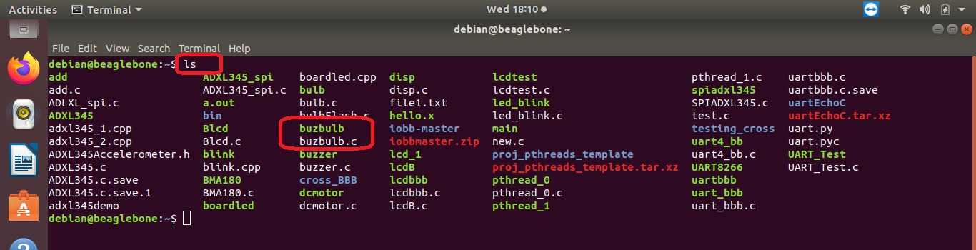
Terminal final output
After adding the file in Beaglebone. By using command “PUT”
Second is to locate the by using “ls” command.
We must locate the file “ buzbulb.c”

Slide 16
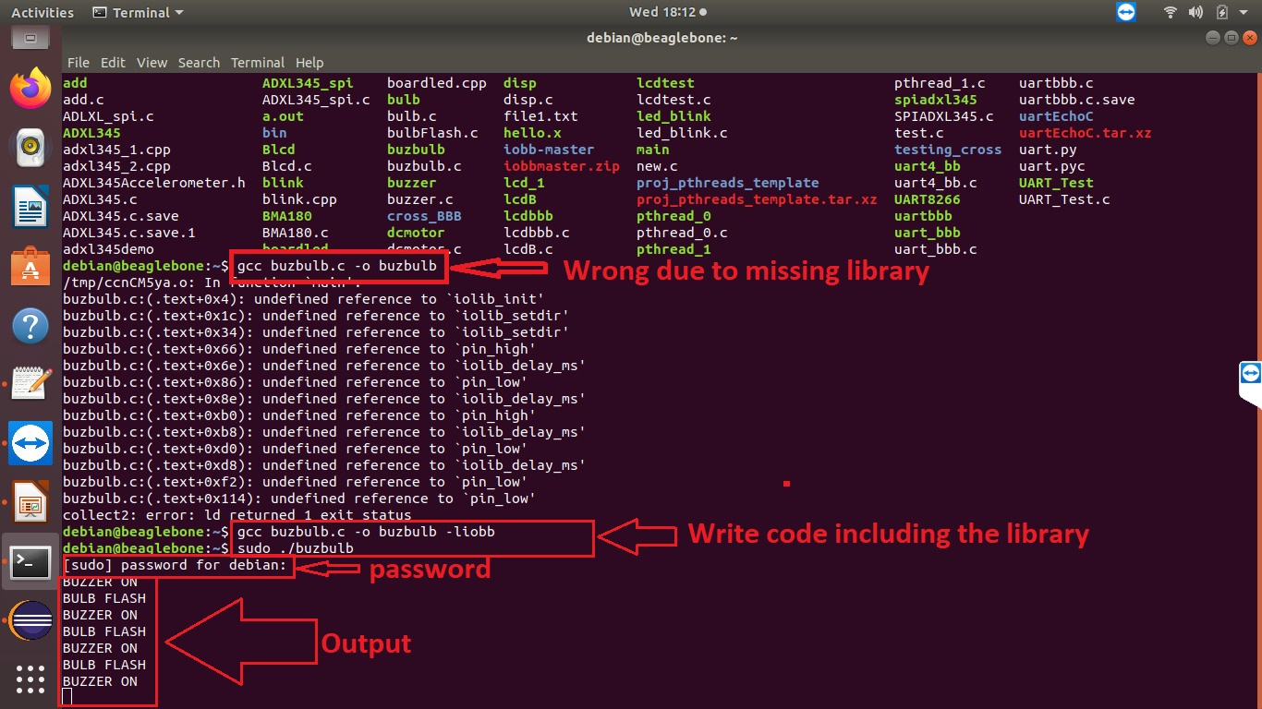
Terminal final output(cont.d)
After locating the file, we need to entre the command “ gcc buzbulb.c –o buzbulb –liobb”
Next command is “ sudo ./buzbulb” to start the code
Then Beaglebone needs the password “temppwd”
Results are as bulbs switches on and off according to the preset time in code.

Slide 17
REFERENCES
2 Channel DC 5V Relay Module with Optocoupler Low Level Trigger Expansion Board for Arduino Raspberry Pi. (n.d.). Retrieved from https://www.sunfounder.com/2channel-dc5v-relay-module-with-optocoupler.html
Shabaz123. (2019, august 17). Retrieved from https://github.com/shabaz123/iobb/blob/master/BBBio_lib/BBBiolib.c
Piezoelectric Buzzer. (n.d.). Retrieved from https://squishycircuits.com/products/piezoelectric-buzzer
MAS6240 Piezo Driver IC for Multi-sound. (n.d.). Retrieved from https://www.mas-oy.com/portfolio/mas6240/?gclid=Cj0KCQiAqdP9BRDVARIsAGSZ8Akz9wbYVmUXOtN5BanJnNjdXN1LoIrn-OldeFk_c1kIYMnHSbi4-UAaAoJ2EALw_wcB

Slide 18
REFERENCES
Nada, Globe Bulb DC 12 Volt LED Lights 24 Volt Compatible 7W Night Lamp A19 E26 Base Office RV Replacement Energy Efficient Saving Warm White 3000K, Pack of 1. (n.d.). Retrieved from https://www.amazon.ca/gp/product/B0781M55BN/ref=ppx_yo_dt_b_asin_title_o08_s02?ie=UTF8&psc=1
5V 5-Pin Relay. (2017. September 26). Retrieved from https://components101.com/5v-relay-pinout-working-datasheet
Legrand-Pass & Seymour 8052CC10 Medium Base Porcelain Lamp Holder, Bracket Mounted 660-watt 250-volt. (n.d.). Retrieved from https://www.amazon.ca/Legrand-Pass-Seymour-8052CC10-Porcelain-660-watt/dp/B000BPEDZC/ref=sr_1_27?dchild=1&keywords=Bulb+holder&qid=1605747574&sr=8-27
SunFounder 2 Channel DC 5V Relay Module with Optocoupler Low Level Trigger Expansion Board for for Arduino R3 MEGA 2560 1280 DSP ARM PIC AVR STM32 Raspberry Pi. (n.d.). Retrieved from https://www.amazon.ca/gp/product/B00E0NTPP4/ref=ppx_yo_dt_b_asin_title_o08_s00?ie=UTF8&psc=1

